Slide 1
Achieving humanitarian excellence through advancing meaningful youth engagement
Policy, Strategy, Knowledge department
Partnerships Division
Marcel Stefanik
Global Coordinator
marcel.stefanik@ifrc.org

Slide 2
Non-Violence and Peace
Youth Engagement
Gender and Diversity
Social Inclusion
Volunteering Development
Humanitarian Education
Human dignity

Slide 3
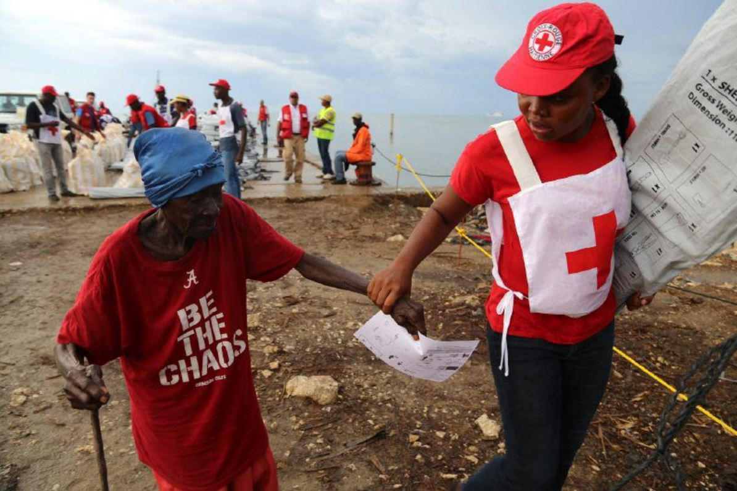
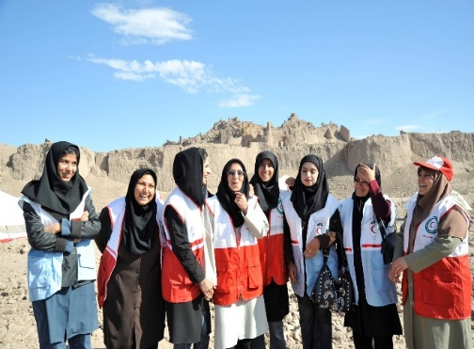
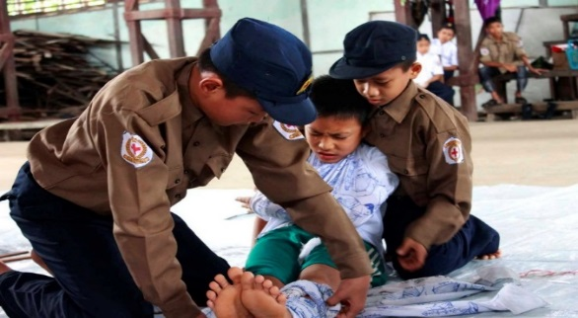
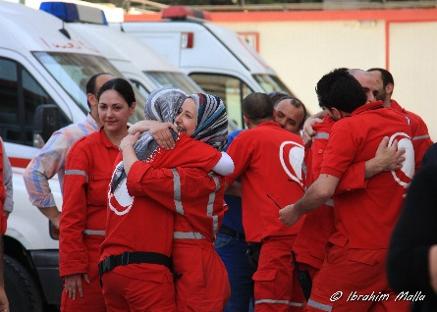
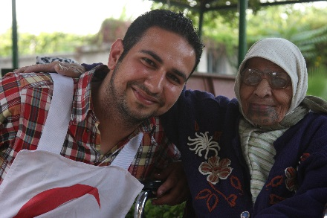
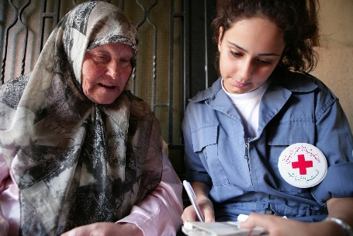
We are a global leader in youth engagement
Championing the youth development and youth-led action
Youth doing more, doing better, and reaching further
Inter-generational partnerships & Youth-led peer approaches
Transforming communities from “within” – Creating a better world
Notes:
Global leaders – YC, Compact Co-Lead, Etc.
Today young people represent both the biggest cohort of people under 30 in the history and a growing constituency of communities affected by humanitarian crises. Children, adolescents, and young adults are however largely overlooked, their potential is often untapped, and too often they are missing at the decision-making tables where the presence and future of communities they live-in are being shaped.
Half of the world’s population is under the age of 30.
Youth between 15 and 24 years old are a significant force totalling to 1.8 billion, most of which live in developing countries and usually represent the largest proportion of the country’s population.
500 million young people live on less than 2 USD per day.
Making up more than a half of the 1.5 billion people, youth under 30 represent the largest age group living in conflict or fragile situations.
In 2015, children and youth constituted 51% of the forcibly displaced populations.
More than 2.6 million young people aged 10 to 24 die each year in the world, mostly due to preventable causes.
In any given year, about 20% of adolescents will experience a mental health problem (depression or anxiety).
AIDS is the second most common cause of death among adolescents globally.
The youth unemployment rate is 13.1% (3 times the adult unemployment rate).
Working poverty affects as many as 169 million youth in the world.
225 million youth, or 20% of all youth in the developing world are not in education, employment or training. More here.

Slide 4
Why do we invest in youth engagement?
Capacity to deliver
Continuity
Leadership renewal
Progress
Notes:
For the RCRC, young people embody the most valuable RCRC resource and asset, as they represent more than a half of RCRC 17 million volunteers globally and are a driving force of our humanitarian assistance locally.
Youth engagement is therefore a strategic vehicle in achieving the RCRC humanitarian excellence and ensuring continuity, progress, and renewal within 190 National Societies. Young people help us identify the missing pieces in our engagement strategy, foster locally-driven solutions, and thus ensure that our National Societies remain relevant local actors before, during, and after humanitarian crises.
For the IFRC, engagement of children, adolescents, and young adults is not a token gesture. In addition to the engagement of young people as members of affected communities and catalysts of the RCRC humanitarian action, the IFRC values and invests in promoting the voice and leadership of young people. With the National Societies, we prepare and accompany, empower, and enable children, adolescents, and young adults to shape humanitarian aid and development. Engagement of young people with IFRC is often described as a real-life leadership experience that encourages young people to do the “right thing” and give back to their communities.
More than half of the 17 million RCRC volunteers are people under 30.
89 NSs have a youth representative in their NS’s Governing board but in only 31 NSs these representatives are elected solely by their youth peers.
116 NSs lack the Youth Policy stipulating the role of youth in achieving their mission and vision.
97 NSs operate without a strategic plan for youth engagement.
Only 69 NSs have a youth-led governance structure in place (National RCRC Youth Council or National RCRC Youth board).
Only 75 NSs have a Youth Leadership Development Project/Training.

Slide 5
Youth Engagement
Humanitarian Excellence
Wider Engagement w/Communities
Community Resilience
Youth as LEADERS
Youth as VOLUNTEERS
Youth as MEMBERS OF AFFECTED COMMUNITIES
Education
Empower-ment
Enabling Enviro
Notes:
How do we see the connections between the YE, Hum Excellence, and Community Resilience? – Infographics one
How do we go about meaningful youth engagement?
In creating a better world, our aspiration is to help improve the lives of children, adolescents and young adults through three inter-connected Red Cross Red Crescent (RCRC) pathways of meaningful youth engagement:
1. Young people as members of affected communities,
2. Young people as contributors to solutions, and
3. Young people as leaders.
Complemented by the 3Es, these pathways represent the building blocks of the IFRC Youth Engagement Strategy.
Building on our role in the development of the WHS Compact for Young People in Humanitarian Action as well as the Pledge for Youth Engagement for a Better World made at our own 32nd International Conference, we aspire to ensure that the priorities, needs, and rights of young people affected by disasters, conflict, forced displacement, and other humanitarian crises, are addressed and that they are at the decision-making tables where the presence and future of communities they live-in are being shaped.

Slide 6
Vision of youth engagement 2020
Young people will be living the RCRC Fundamental principles and Humanitarian values and they will excel as key RCRC actors in both alleviating human suffering and advocating for equality.
In the RCRC, young people will be treated with respect and as equal partners to adults. Intergenerational cooperation throughout the RCRC will result in humanitarian actions and extended partnerships that will increase the number of safe and resilient communities around the world.
Young people, including those outside of the mainstream, will have opportunities responsive to their needs, potential, ambitions, and dreams and will be able to evolve personally, and secure livelihoods for themselves and their families.

Slide 7
Vision of youth engagement 2020 (cont.)
Young people, knowledgeable and empowered to stay healthy, will assume roles as responsible members of their communities, will care for and engage with those in the shadows and those affected by the “Solferinos of the day”, being motivated by free will, as opposed to a desire for material or financial gain or by external social, economic, and political pressure.
Through, recognition of youth contributions and creation of space for youth by adults, young people will develop ownership for nurturing their communities and will favour ethical decisions that lead to collective community advancement over decisions of individual gain.

Slide 8
RCRC Youth Engagement Principles
Youth engagement is intrinsic to building strong National Societies.
RC RC volunteerism is central to youth engagement and is an effective and meaningful way of youth civic engagement.
Education, Empowerment, and Enabling environments for young people are vital for youth engagement.
Youth are agents of change addressing global humanitarian challenges pertinent to local communities.
Youth in decision-making at all levels of management, governance, and service delivery are crucial for intergenerational transfer of experiences and continuity.
Notes:
First two slide of this presentation are to set the framework for the introduction of the IFRC Y.E.S.
This slide is about value and directions for youth engagement in RCRC. With the following slide, framework for the IFRC Y.E.S. introduction should be complete.
Keywords are in bold on the slide.
More details on Youth engagement in the IFRC:
Inspired by the Solferino Youth Declaration (2009), the IFRC Strategy 2020 recognises engagement of young people through RC RC voluntary programs and services as intrinsic to building and sustaining strong National Societies able to deliver relevant services to vulnerable people country-wide, through a network of volunteer-based units, for as long as needed.
Fact: According to the 110 National Societies, who took part in the survey for the Global RC RC Youth Consultation (2011), youth volunteering is a meaningful way of contributing directly and in diverse ways to the service delivery at the community level.
Strategy 2020 also urges National Societies to invest in education, empowerment, and creation of enabling environments for young people to be and become agents of change who lead and participate in building and sustaining their local communities. Moreover, National Societies are called for engaging young people in decision making at all levels of management, governance, and program and service delivery in order to ensure intergenerational transfer of knowledge, experiences, and continuity within the RC RC.
Fact: Despite young people representing more than a half of the global active volunteer base, still less than 60% of National Societies confirmed having a youth representative in their governing board*
By adopting the IFRC Youth Policy at the General Assembly 2011 the National Societies proclaimed value of the important role and contribution of children, adolescents, and young adults and thus committed to scale up their efforts to increase youth engagement as a key driver in the development of our National Societies and our Movement.
Fact: Youth contribution should be recognised at all levels and young people should be provided with relevant training, resources, and enabling environments in order to enhance their skills needed to advance in different positions in the Movement.*
While the IFRC Youth Policy (2011) describes why to engage young people, it must be complemented by the IFRC Youth Engagement Strategy (IFRC YES), a strategic framework that would provide specific guidance to National Societies on how to increase meaningful youth engagement.

Slide 9
IFRC Y.E.S.
“Strong youth for strong RCRC and safe and resilient communities”
Youth as leaders
Youth education
Youth
empowerment
RCRC creating enabling environments for youth
Strategic directions and
Recommended Actions for:
Youth as volunteers
Youth as members of affected
communities
Humanitarian Education
IFRC Youth policy (2011)
IFRC Strategy 2020
Solferino Youth Declaration (2009)
Notes:
In this slide, key components/building blocks of the IFRC Y.E.S. are brought together.
Definitions are to be introduced – however, one should be reasonable with the level of details. Depending on the audience, once could probably focus and feature mainly on the new aspects of the definitions.
3Es concept (IFRC own framework introduced at the GYC 2012)
Importance of Youth Education
For children, adolescents, and young adults to take the lead in their capacities of volunteers, members, staff of National Societies, and beneficiaries, they need to be educated (in non-formal, formal, and informal settings). More specifically, they need to be provided with opportunities for development and practice of relevant life skills, values, and technical and administrative competences. Education means access to resources and equal opportunities.
Importance of Youth Empowerment
In regard to specific vulnerabilities due to combination of age, social position, and societal status, children, adolescents, and young adults need to be empowered throughout their engagement with Red Cross Red Crescent as volunteers and beneficiaries. More specifically, National Societies’ programs and services should allow for processes in which young people gradually acquire the ability, authority, and agency to make decisions and implement change in their own lives and the lives of other people (children, adolescents, young adults, and adults). Youth Empowerment means engaging young people in what and how National Societies do with and for young people.
Importance of Enabling environments for Youth
For educated and empowered children, adolescents, and young people to become agents of change participating and leading within National Societies’ service delivery, governance, leadership, and management, National Societies need to create enabling environments. More specifically, National Societies need to be educated in the realms of youth engagement and youth development. Changes of institutional environments, cultures, processes, structures, policies, regulations, etc., to enable thriving youth action in all domains and at all levels must be evidence based and informed by intergenerational dialogue. Enabling environments for youth are about realizing potential of groups and individuals within organisation.
Key youth definitions (Stemming from the IFRC Youth policy and amended by the Drafting team of the IFRC YES; endorsed by the Youth Commission)
Youth and Young people
The terms "youth" and "young people" in the IFRC cover people in the age range of 5 to 30 years. This includes children (5 to 11 years old), adolescents (12 to 17 years old), and young adults (18 to 30 years old). National Societies are guided reasonably by this range in adopting their own definitions according to local laws, social norms and cultural contexts.
Youth as Leaders
In Red Cross Red Crescent, youth can take a lead in their capacity as volunteers, members, and staff. Youth leadership is not exclusively about the title and position. It also entails and refers to specific abilities or unique qualities of young people to inspire and influence positive change by own actions in others or within their communities. Red Cross Red Crescent Youth leaders represent their peers and advocate for vulnerable and marginalized groups.
In-line with the IFRC Youth Policy (2011), Red Cross Red Crescent Youth leaders tackle contemporary and emerging issues; innovate and adopt modern media and IT; serve as inter-cultural ambassadors, agents of change, community mobilisers; participate in decision making, governance, and management; and utilise peer to peer approaches through their engagement in diverse Red Cross Red Crescent youth networks.
Youth as Volunteers
In Red Cross Red Crescent, young volunteers take the lead in planning, designing, delivering and reviewing of programs and services of National Societies. As deliverers of service and programs, they may have specific needs.
In general, Red Cross Red Crescent volunteers are individuals who carry out volunteering activities for a National Society, occasionally or regularly, without intention for personal gain. They do this by delivering services directly and indirectly to vulnerable people and through seeking to prevent and reduce human suffering and social exclusion where they can, based on their skills, capacities, and experiences. It is an obligation and responsibility of National Societies to ensure protection, safety, and security of all volunteers throughout their engagement.
Youth as beneficiaries
In Red Cross Red Crescent, young beneficiaries are all children, adolescents, and young adults who participate in, benefit from, and/or are empowered by Red Cross Red Crescent programmes and services.
Young beneficiaries are not passive receivers of aid. On the contrary, they are involved in the planning, design, delivery, and review of Red Cross Red Crescent programs and services affecting them. Throughout their engagement, National Societies must provide all the age categories of young beneficiaries with opportunities for advancement of their personal and professional development in the effort to enable their empowerment and giving back to their communities.

Slide 10
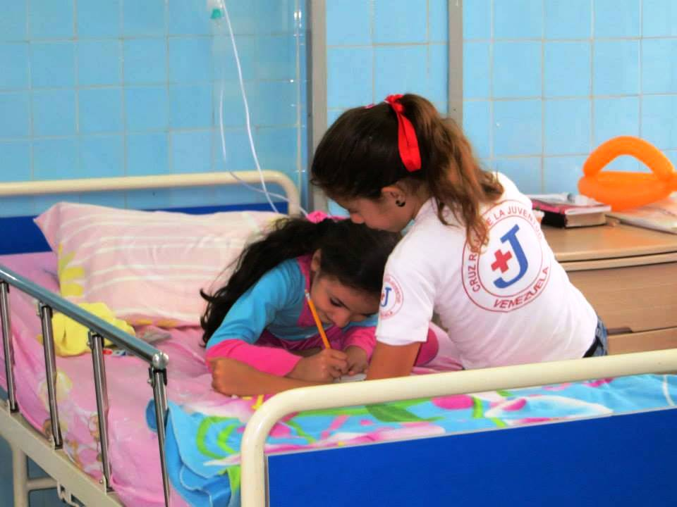
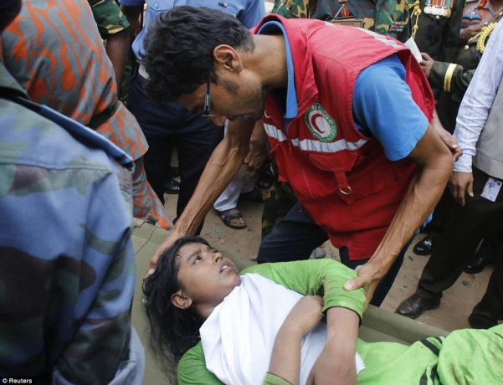
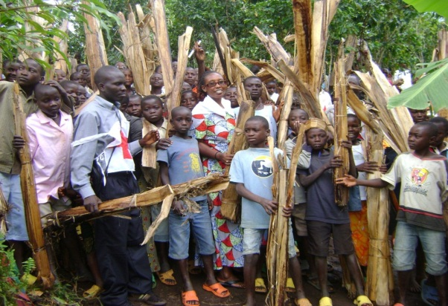
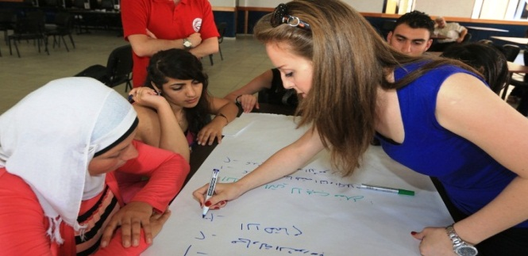
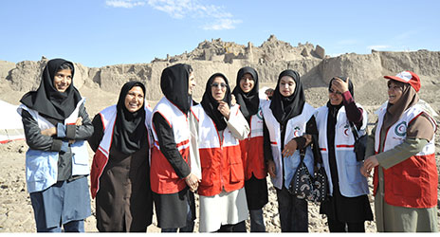
Corner stones of resilience in the Y.e.S.
“Well-equipped, Empowered, Healthy and enabled
children, adolescents, and young adults as agents of change”
Youth education
Youth
empowerment
RCRC creating enabling environments for youth
Humanitarian Education
Notes:
In this slide, key components/building blocks of the IFRC Y.E.S. are brought together.
Definitions are to be introduced – however, one should be reasonable with the level of details. Depending on the audience, once could probably focus and feature mainly on the new aspects of the definitions.
3Es concept (IFRC own framework introduced at the GYC 2012)
Importance of Youth Education
For children, adolescents, and young adults to take the lead in their capacities of volunteers, members, staff of National Societies, and beneficiaries, they need to be educated (in non-formal, formal, and informal settings). More specifically, they need to be provided with opportunities for development and practice of relevant life skills, values, and technical and administrative competences. Education means access to resources and equal opportunities.
Importance of Youth Empowerment
In regard to specific vulnerabilities due to combination of age, social position, and societal status, children, adolescents, and young adults need to be empowered throughout their engagement with Red Cross Red Crescent as volunteers and beneficiaries. More specifically, National Societies’ programs and services should allow for processes in which young people gradually acquire the ability, authority, and agency to make decisions and implement change in their own lives and the lives of other people (children, adolescents, young adults, and adults). Youth Empowerment means engaging young people in what and how National Societies do with and for young people.
Importance of Enabling environments for Youth
For educated and empowered children, adolescents, and young people to become agents of change participating and leading within National Societies’ service delivery, governance, leadership, and management, National Societies need to create enabling environments. More specifically, National Societies need to be educated in the realms of youth engagement and youth development. Changes of institutional environments, cultures, processes, structures, policies, regulations, etc., to enable thriving youth action in all domains and at all levels must be evidence based and informed by intergenerational dialogue. Enabling environments for youth are about realizing potential of groups and individuals within organisation.
Key youth definitions (Stemming from the IFRC Youth policy and amended by the Drafting team of the IFRC YES; endorsed by the Youth Commission)
Youth and Young people
The terms "youth" and "young people" in the IFRC cover people in the age range of 5 to 30 years. This includes children (5 to 11 years old), adolescents (12 to 17 years old), and young adults (18 to 30 years old). National Societies are guided reasonably by this range in adopting their own definitions according to local laws, social norms and cultural contexts.
Youth as Leaders
In Red Cross Red Crescent, youth can take a lead in their capacity as volunteers, members, and staff. Youth leadership is not exclusively about the title and position. It also entails and refers to specific abilities or unique qualities of young people to inspire and influence positive change by own actions in others or within their communities. Red Cross Red Crescent Youth leaders represent their peers and advocate for vulnerable and marginalized groups.
In-line with the IFRC Youth Policy (2011), Red Cross Red Crescent Youth leaders tackle contemporary and emerging issues; innovate and adopt modern media and IT; serve as inter-cultural ambassadors, agents of change, community mobilisers; participate in decision making, governance, and management; and utilise peer to peer approaches through their engagement in diverse Red Cross Red Crescent youth networks.
Youth as Volunteers
In Red Cross Red Crescent, young volunteers take the lead in planning, designing, delivering and reviewing of programs and services of National Societies. As deliverers of service and programs, they may have specific needs.
In general, Red Cross Red Crescent volunteers are individuals who carry out volunteering activities for a National Society, occasionally or regularly, without intention for personal gain. They do this by delivering services directly and indirectly to vulnerable people and through seeking to prevent and reduce human suffering and social exclusion where they can, based on their skills, capacities, and experiences. It is an obligation and responsibility of National Societies to ensure protection, safety, and security of all volunteers throughout their engagement.
Youth as beneficiaries
In Red Cross Red Crescent, young beneficiaries are all children, adolescents, and young adults who participate in, benefit from, and/or are empowered by Red Cross Red Crescent programmes and services.
Young beneficiaries are not passive receivers of aid. On the contrary, they are involved in the planning, design, delivery, and review of Red Cross Red Crescent programs and services affecting them. Throughout their engagement, National Societies must provide all the age categories of young beneficiaries with opportunities for advancement of their personal and professional development in the effort to enable their empowerment and giving back to their communities.

Slide 11
All NSs committed to:
Adopting own Youth Policy
Adopting own Youth Engagement Strategy
Ensuring a seat for Youth representatives across the NS’s governance structures
Establishing Youth-led governance structures
Establish Youth-led programming
Nurturing inter-generational cooperation
Investing in peer approaches

Slide 12
2017 Priorities
1. Implementing global policy, strategy & quality standards
Y.E.S. Toolkit
IFRC’s Youth Innovation Fellowship Initiative
2. Collaboration led by young people
Youth Network in the Middle-East and North Africa.
IFRC Youth on the Move Award 2017
3. Enabling youth leadership in the RCRC
Statutory meetings 2017 and Global For a
“Youth Leadership in the RCRC” Study
WHS Compact for Young People in Humanitarian Action
Notes:
We acknowledge that the RCRC programmes and operations as well as the governance and operational structures with a strong meaningful youth engagement component enable us to engage communities more effectively and better tackle vulnerabilities pertinent to diverse groups, including the heterogenous constituency of youth. We are therefore committed to championing the alignment between the existing humanitarian aid practice with the key principles of meaningful youth engagement to nurture impactful youth-led action across the humanitarian landscape.
Youth Engagement is currently embedded in the Strategy of Implementation #1:” Strengthen National Society capacities and ensure sustained and relevant Red Cross and Red Crescent presence in communities” and it is an acknowledged strand of the National Society Development. In addition, the Secretariat has mainstreamed youth as a priority stakeholder in the Innovation portfolio and throughout the Areas of Focus 6 and 7: Culture of Non-Violence and Peace and Social Inclusion, which cover Child protection, Humanitarian Education, incl. the YABC.
In the coming 2 years, the IFRC will scale-up its leadership role and investment in:
Implementation of youth engagement policy, strategy, and quality standards;
Peer-to-peer learning, coaching schemes, and networks; and
Youth leadership development.

Slide 13
Why to partner with the RCRC on YE? Summary
We value and invest
We engage and recognise
We shape and champion

Slide 14
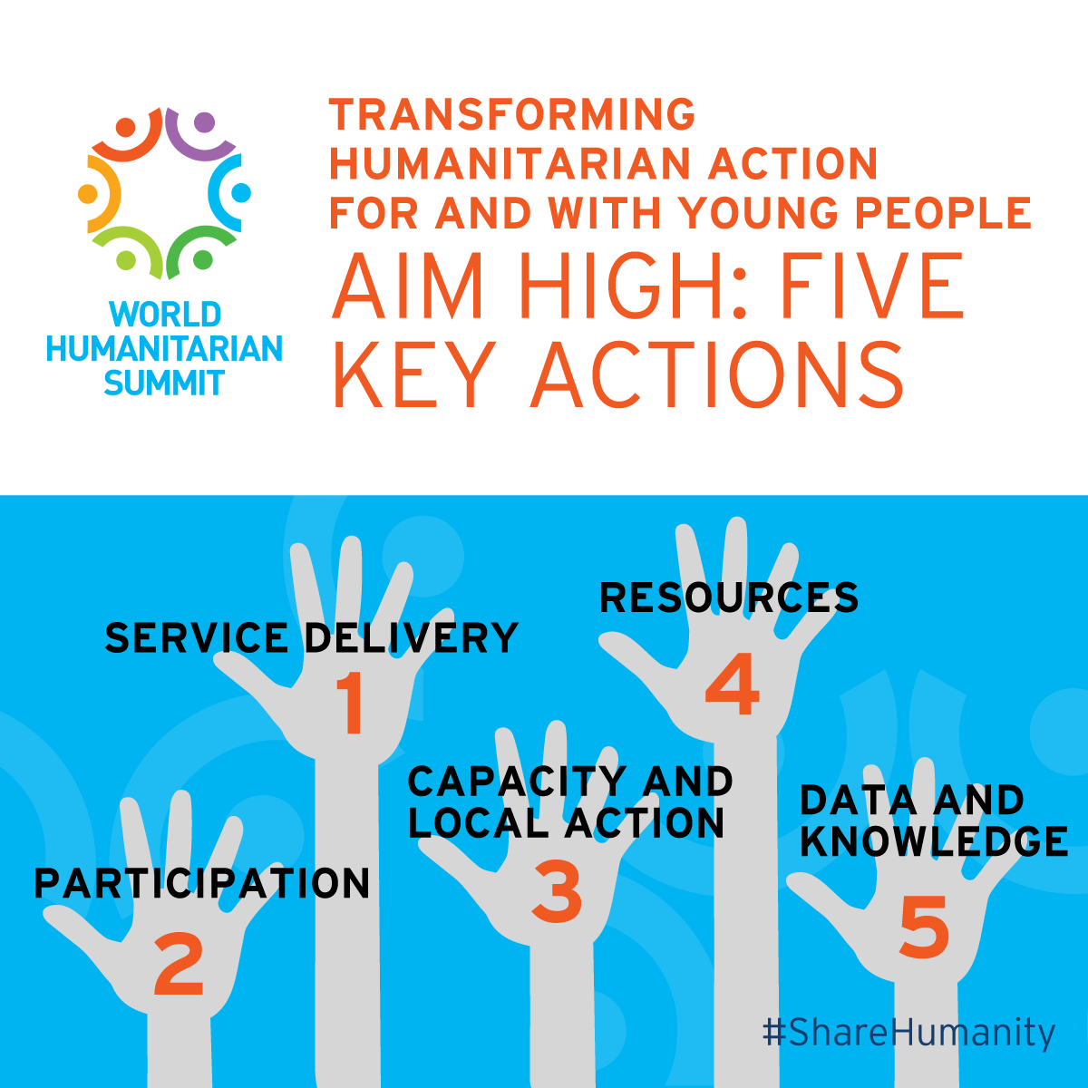

Slide 15
Additional info

